Slide 1

SRVUSD Summer School 2021

Slide 2

Purpose of Summer School
Support students’ understanding of the essential standards needed for their next grade level/course.
Support students’ social emotional well-being.
Opportunity to remediate a grade of D/F.

Slide 3

Format
All Levels
In Person
5 days per week
Approximately 4.5 hours/day
Alternative Remote Learning will be available for students who are identified as needing summer school, but who are unable to commit to attending in person.

Slide 4

Locations
3 or 4 elementary locations: Golden View, Rancho Romero, Live Oak (will add a 4th site, if needed).
Iron Horse Middle School will support our middle school students.
San Ramon Valley High School will support our high school students.

Slide 5
Dates
DATES/TIMES | Dates | Sessions | Hours
Elementary (ELD, Intervention) | 6/14 - 7/9** | 1 Session | 8:15 AM - 12:45 PM
SDC Preschool | 6/14-7/9 ** | 1 Session | AM Class 8:00 AM - 10:00 AM PM Class 10:30 AM- 12: 30 PM
ESY Elementary | 6/14-7/9 ** | 1 Session | 8:00 AM - 12:30 PM
Middle School ( ELD, Intervention) | 6/14 - 7/9** | Session 1: 6/14 - 6/24 Session 2: 6/28 - 7/9 | 8:15 AM - 12:45 PM
Math Advancement Program | 5/18 - 7/28** | 1 Session
High School (ELD, Remediation, Scholastic Bridge) | 6/14 - 7/23** | Session 1: 6/14 - 7/1 Session 2: 7/6 - 7/23 | 8:15 AM - 12:45 PM
ESY (MS, HS) | 6/14--7/9 | 1 Session | 8:00 AM- 12:30 PM
Adult Transition, Reach | 6/14 - 7/9** | 1 Session | 9:00 AM-12:30 PM

Slide 6

Programs
Elementary: Intervention, ESY (Extended School Year), ELD (English Language Development)
Middle School: Intervention, ESY, ELD, middle school math advancement program (MAP)
High School: Remediation/Intervention, ESY, ELD, 9th grade Scholastic Bridge

Slide 7

Students
Elementary
1s and 2s on report card
Targeted, essential standard intervention
Social emotional support
Middle
Intervention: Students with Ds and Fs ELA and math
Targeted, essential standard intervention
Social emotional support
High
Intervention/remediation: Fs, Ds where there is room
Scholastic Bridge: Incoming 9th graders who need academic, study skills, executive functioning support
Social emotional support
Notes:
Need to explore ways to support our students SEL--- especially students who have been remote all year--

Slide 8

Access/ Enrollment
Elementary and Middle School:
Google form recommending summer school will be sent to families from teacher, counselor or administrator. Families will confirm/decline enrollment.
High School:
Counselors will meet with students individually and give enrollment form in person or virtually.

Slide 9

Intervention/
Family Request
Families/students who weren’t recommended for summer school may submit a request to enroll their child in summer school to receive academic (math/ELA, and/or SEL) support
Families will apply through their home site
  Google form
Our goal is to provide an opportunity for all students who want to attend summer school

Slide 10
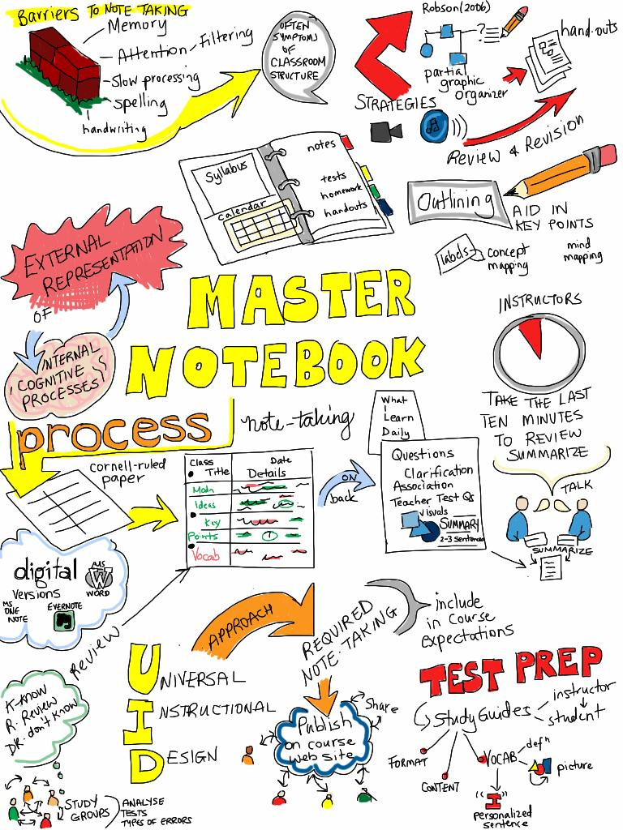
Curriculum & Instruction
Students will have pre and post universal assessments for ELA and math (e.g. Fastbridge).
Post assessment data will be communicated to fall 2021 teachers.
A combination of teacher created curriculum and online platforms will be used, depending on the data and the needs of students.

